Slide 1
Chapter 13 - Graphical User Interface Components: Part 1
Outline
13.1 Introduction
13.2 Overview of Swing Components
13.3 JLabel
13.4 Event Handling
13.5 TextFields
13.6 How Event Handling Works
13.7 JButton
13.8 JCheckBox and JRadioButton
13.9 JComboBox
13.10 JList
13.11 Multiple-Selection Lists
13.12 Mouse Event Handling
13.13 Adapter Classes
13.14 Key Event Handling

Slide 2
Chapter 13 - Graphical User Interface Components: Part 1
Outline
13.15 Layout Managers
13.15.1 FlowLayout
13.15.2 BorderLayout
13.15.3 GridLayout
13.16 Panels
13.17 (Optional Case Study) Thinking About Objects: Use Cases

Slide 3
13.1 Introduction
Graphical User Interface (GUI)
  Gives program distinctive “look” and “feel”
  Provides users with basic level of familiarity
  Built from GUI components (controls, widgets, etc.)
    User interacts with GUI component via mouse, keyboard, etc.

Slide 4
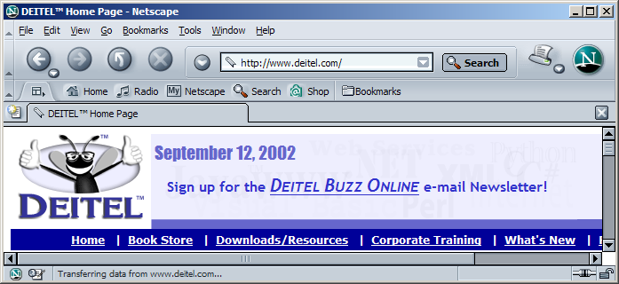
Fig. 13.1 Netscape window with GUI components
button
menus
menu bar
combo box
scroll bars

Slide 5
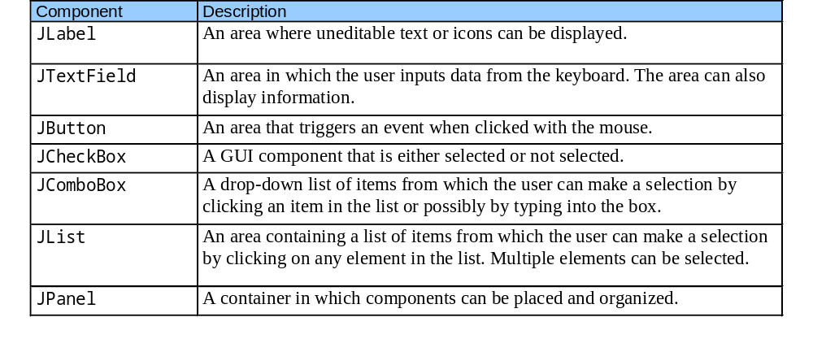
Fig. 13.2 Some basic GUI components

Slide 6
13.2 Overview of Swing Components
Swing GUI components
  Package javax.swing
  Components originate from AWT (package java.awt)
  Contain look and feel
    Appearance and how users interact with program
  Lightweight components
    Written completely in Java

Slide 7
13.2 Overview of Swing Components
Class Component
  Contains method paint for drawing Component onscreen
Class Container
  Collection of related components
  Contains method add for adding components
Class JComponent
  Pluggable look and feel for customizing look and feel
  Shortcut keys (mnemonics)
  Common event-handling capabilities

Slide 8
Fig. 13.3 Common superclasses of many of the Swing components
Object
Object
Component
Component
Container
Container
JComponent
JComponent

Slide 9
13.3 JLabel
Label
  Provide text on GUI
  Defined with class JLabel
  Can display:
    Single line of read-only text
    Image
    Text and image

Slide 10
LabelTest.java
Line 8
Line 20
Line 21
1 // Fig. 13.4: LabelTest.java
2 // Demonstrating the JLabel class.
3 import java.awt.*;
4 import java.awt.event.*;
5 import javax.swing.*;
6
7 public class LabelTest extends JFrame {
8 private JLabel label1, label2, label3;
9
10 // set up GUI
11 public LabelTest()
12 {
13 super( "Testing JLabel" );
14
15 // get content pane and set its layout
16 Container container = getContentPane();
17 container.setLayout( new FlowLayout() );
18
19 // JLabel constructor with a string argument
20 label1 = new JLabel( "Label with text" );
21 label1.setToolTipText( "This is label1" );
22 container.add( label1 );
23
Declare three JLabels
Create first JLabel with text “Label with text”
Tool tip is text that appears when user moves cursor over JLabel

Slide 11
LabelTest.java
Lines 16-17
Lines 32-37
24 // JLabel constructor with string, Icon and alignment arguments
25 Icon bug = new ImageIcon( "bug1.gif" );
26 label2 = new JLabel( "Label with text and icon", bug,
27 SwingConstants.LEFT );
28 label2.setToolTipText( "This is label2" );
29 container.add( label2 );
30
31 // JLabel constructor no arguments
32 label3 = new JLabel();
33 label3.setText( "Label with icon and text at bottom" );
34 label3.setIcon( bug );
35 label3.setHorizontalTextPosition( SwingConstants.CENTER );
36 label3.setVerticalTextPosition( SwingConstants.BOTTOM );
37 label3.setToolTipText( "This is label3" );
38 container.add( label3 );
39
40 setSize( 275, 170 );
41 setVisible( true );
42
43 } // end constructor
44
45 public static void main( String args[] )
46 {
47 LabelTest application = new LabelTest();
48 application.setDefaultCloseOperation( JFrame.EXIT_ON_CLOSE );
49 }
Create second JLabel with text to left of image
Create third JLabel with text below image

Slide 12
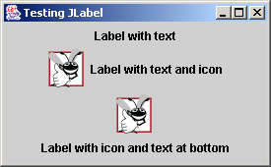
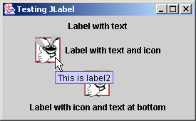
LabelTest.java
50
51 } // end class LabelTest

Slide 13
13.4 Event Handling
GUIs are event driven
  Generate events when user interacts with GUI
    e.g., moving mouse, pressing button, typing in text field, etc.
    Class java.awt.AWTEvent

Slide 14
Fig. 13.5 Some event classes of package java.awt.event
Object
Object
ActionEvent
EventObject
ActionEvent
EventObject
AdjustmentEvent
AWTEvent
AdjustmentEvent
ContainerEvent
AWTEvent
ItemEvent
ContainerEvent
ItemEvent
FocusEvent
TextEvent
FocusEvent
TextEvent
PaintEvent
ComponentEvent
PaintEvent
ComponentEvent
WindowEvent
WindowEvent
InputEvent
InputEvent
KeyEvent
MouseEvent
KeyEvent
MouseEvent
MouseWheelEvent
MouseWheelEvent

Slide 15
13.4 Event Handling
Event-handling model
  Three parts
    Event source
      GUI component with which user interacts
    Event object
      Encapsulates information about event that occurred
    Event listener
      Receives event object when notified, then responds
  Programmer must perform two tasks
    Register event listener for event source
    Implement event-handling method (event handler)

Slide 16
Fig. 13.6 Event-listener interfaces of package java.awt.event
«interface»
ActionListener
interface
ActionListener
«interface»
AdjustmentListener
interface
AdjustmentListener
«interface»
ComponentListener
interface
ComponentListener
«interface»
ContainerListener
interface
ContainerListener
«interface»
FocusListener
interface
FocusListener
«interface»
EventListener
«interface»
ItemListener
interface
EventListener
interface
ItemListener
«interface»
KeyListener
interface
KeyListener
«interface»
MouseListener
interface
MouseListener
«interface»
MouseMotionListener
interface
MouseMotionListener
«interface»
TextListener
interface
TextListener
«interface»
TextListener
interface
WindowListener

Slide 17
13.5 TextFields
JTextField
  Single-line area in which user can enter text
JPasswordField
  Extends JTextField
  Hides characters that user enters

Slide 18
TextFieldTest.java
Lines 8-9
Line 20
Line 24
1 // Fig. 13.7: TextFieldTest.java
2 // Demonstrating the JTextField class.
3 import java.awt.*;
4 import java.awt.event.*;
5 import javax.swing.*;
6
7 public class TextFieldTest extends JFrame {
8 private JTextField textField1, textField2, textField3;
9 private JPasswordField passwordField;
10
11 // set up GUI
12 public TextFieldTest()
13 {
14 super( "Testing JTextField and JPasswordField" );
15
16 Container container = getContentPane();
17 container.setLayout( new FlowLayout() );
18
19 // construct textfield with default sizing
20 textField1 = new JTextField( 10 );
21 container.add( textField1 );
22
23 // construct textfield with default text
24 textField2 = new JTextField( "Enter text here" );
25 container.add( textField2 );
26
Declare three JTextFields and one JPasswordField
First JTextField contains empty string
Second JTextField contains text “Enter text here”

Slide 19
TextFieldTest.java
Line 30
Line 34
Lines 39-42
27 // construct textfield with default text,
28 // 20 visible elements and no event handler
29 textField3 = new JTextField( "Uneditable text field", 20 );
30 textField3.setEditable( false );
31 container.add( textField3 );
32
33 // construct passwordfield with default text
34 passwordField = new JPasswordField( "Hidden text" );
35 container.add( passwordField );
36
37 // register event handlers
38 TextFieldHandler handler = new TextFieldHandler();
39 textField1.addActionListener( handler );
40 textField2.addActionListener( handler );
41 textField3.addActionListener( handler );
42 passwordField.addActionListener( handler );
43
44 setSize( 325, 100 );
45 setVisible( true );
46
47 } // end constructor TextFieldTest
48
49 public static void main( String args[] )
50 {
51 TextFieldTest application = new TextFieldTest();
52 application.setDefaultCloseOperation( JFrame.EXIT_ON_CLOSE );
53 }
Third JTextField contains uneditable text
JPasswordField contains text “Hidden text,” but text appears as series of asterisks (*)
Register GUI components with TextFieldHandler (register for ActionEvents)

Slide 20
TextFieldTest.java
Line 56
Line 59
54
55 // private inner class for event handling
56 private class TextFieldHandler implements ActionListener {
57
58 // process textfield events
59 public void actionPerformed( ActionEvent event )
60 {
61 String string = "";
62
63 // user pressed Enter in JTextField textField1
64 if ( event.getSource() == textField1 )
65 string = "textField1: " + event.getActionCommand();
66
67 // user pressed Enter in JTextField textField2
68 else if ( event.getSource() == textField2 )
69 string = "textField2: " + event.getActionCommand();
70
71 // user pressed Enter in JTextField textField3
72 else if ( event.getSource() == textField3 )
73 string = "textField3: " + event.getActionCommand();
74
75 // user pressed Enter in JTextField passwordField
76 else if ( event.getSource() == passwordField ) {
77 string = "passwordField: " +
78 new String( passwordField.getPassword() );
79 }
Every TextFieldHandler instance is an ActionListener
Method actionPerformed invoked when user presses Enter in GUI field

Slide 21
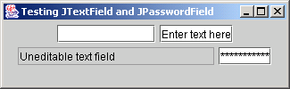
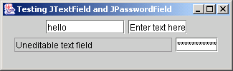
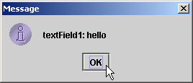
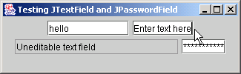
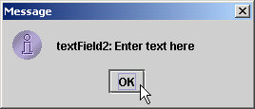
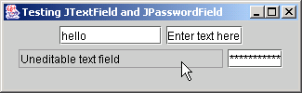
TextFieldTest.java
80
81 JOptionPane.showMessageDialog( null, string );
82
83 } // end method actionPerformed
84
85 } // end private inner class TextFieldHandler
86
87 } // end class TextFieldTest

Slide 22
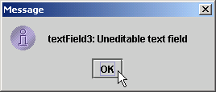
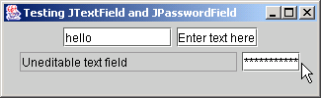
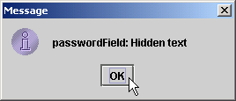
TextFieldTest.java

Slide 23
13.6 How Event Handling Works
Two open questions from Section 13.4
  How did event handler get registered?
    Answer:
      Through component’s method addActionListener
      Lines 39-42 of TextFieldTest.java
  How does component know to call actionPerformed?
    Answer:
      Event is dispatched only to listeners of appropriate type
      Each event type has corresponding event-listener interface
        Event ID specifies event type that occurred

Slide 24
Fig. 13.8 Event registration for JTextField textField1
textField1
handler
listenerList
public void actionPerformed(
ActionEvent event )
{
// event handled here
}
JTextField object
TextFieldHandler object
...
This reference is created by the statement
textField1.addActionListener( handler );

Slide 25
13.7 JButton
Button
  Component user clicks to trigger a specific action
  Several different types
    Command buttons
    Check boxes
    Toggle buttons
    Radio buttons
  javax.swing.AbstractButton subclasses
    Command buttons are created with class JButton
      Generate ActionEvents when user clicks button

Slide 26
Fig. 13.9 Swing button hierarchy
JComponent
JComponent
AbstractButton
AbstractButton
JButton
JToggleButton
JButton
JToggleButton
JCheckBox
JRadioButton
JCheckBox
JRadioButton

Slide 27
ButtonTest.java
Line 8
Line 20
Lines 24-26
1 // Fig. 13.10: ButtonTest.java
2 // Creating JButtons.
3 import java.awt.*;
4 import java.awt.event.*;
5 import javax.swing.*;
6
7 public class ButtonTest extends JFrame {
8 private JButton plainButton, fancyButton;
9
10 // set up GUI
11 public ButtonTest()
12 {
13 super( "Testing Buttons" );
14
15 // get content pane and set its layout
16 Container container = getContentPane();
17 container.setLayout( new FlowLayout() );
18
19 // create buttons
20 plainButton = new JButton( "Plain Button" );
21 container.add( plainButton );
22
23 Icon bug1 = new ImageIcon( "bug1.gif" );
24 Icon bug2 = new ImageIcon( "bug2.gif" );
25 fancyButton = new JButton( "Fancy Button", bug1 );
26 fancyButton.setRolloverIcon( bug2 );
27 container.add( fancyButton );
Create two references to JButton instances
Instantiate JButton with text
Instantiate JButton with image and rollover image

Slide 28
ButtonTest.java
Line 31
Lines 32-33
Line 50
28
29 // create an instance of inner class ButtonHandler
30 // to use for button event handling
31 ButtonHandler handler = new ButtonHandler();
32 fancyButton.addActionListener( handler );
33 plainButton.addActionListener( handler );
34
35 setSize( 275, 100 );
36 setVisible( true );
37
38 } // end ButtonTest constructor
39
40 public static void main( String args[] )
41 {
42 ButtonTest application = new ButtonTest();
43 application.setDefaultCloseOperation( JFrame.EXIT_ON_CLOSE );
44 }
45
46 // inner class for button event handling
47 private class ButtonHandler implements ActionListener {
48
49 // handle button event
50 public void actionPerformed( ActionEvent event )
51 {
52 JOptionPane.showMessageDialog( ButtonTest.this,
53 "You pressed: " + event.getActionCommand() );
54 }
Instantiate ButtonHandler for JButton event handling
Register JButtons to receive events from ButtonHandler
When user clicks JButton, ButtonHandler invokes method actionPerformed of all registered listeners

Slide 29
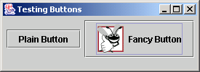
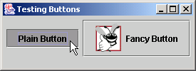
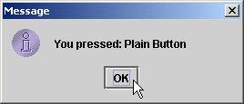
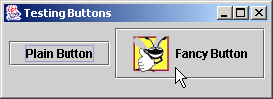
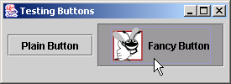
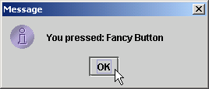
ButtonTest.java
55
56 } // end private inner class ButtonHandler
57
58 } // end class ButtonTest

Slide 30
13.8 JCheckBox and JRadioButton
State buttons
  On/Off or true/false values
  Java provides three types
    JToggleButton
    JCheckBox
    JRadioButton

Slide 31
CheckBoxTest.java
Line 9
Line 22
1 // Fig. 13.11: CheckBoxTest.java
2 // Creating JCheckBox buttons.
3 import java.awt.*;
4 import java.awt.event.*;
5 import javax.swing.*;
6
7 public class CheckBoxTest extends JFrame {
8 private JTextField field;
9 private JCheckBox bold, italic;
10
11 // set up GUI
12 public CheckBoxTest()
13 {
14 super( "JCheckBox Test" );
15
16 // get content pane and set its layout
17 Container container = getContentPane();
18 container.setLayout( new FlowLayout() );
19
20 // set up JTextField and set its font
21 field = new JTextField( "Watch the font style change", 20 );
22 field.setFont( new Font( "Serif", Font.PLAIN, 14 ) );
23 container.add( field );
24
Declare two JCheckBox instances
Set JTextField font to Serif, 14-point plain

Slide 32
CheckBoxTest.java
Lines 26 and 29
Lines 34-35
25 // create checkbox objects
26 bold = new JCheckBox( "Bold" );
27 container.add( bold );
28
29 italic = new JCheckBox( "Italic" );
30 container.add( italic );
31
32 // register listeners for JCheckBoxes
33 CheckBoxHandler handler = new CheckBoxHandler();
34 bold.addItemListener( handler );
35 italic.addItemListener( handler );
36
37 setSize( 275, 100 );
38 setVisible( true );
39
40 } // end CheckBoxText constructor
41
42 public static void main( String args[] )
43 {
44 CheckBoxTest application = new CheckBoxTest();
45 application.setDefaultCloseOperation( JFrame.EXIT_ON_CLOSE );
46 }
47
Instantiate JCheckBoxs for bolding and italicizing JTextField text, respectively
Register JCheckBoxs to receive events from CheckBoxHandler

Slide 33
CheckBoxTest.java
Line 54
Line 65
48 // private inner class for ItemListener event handling
49 private class CheckBoxHandler implements ItemListener {
50 private int valBold = Font.PLAIN;
51 private int valItalic = Font.PLAIN;
52
53 // respond to checkbox events
54 public void itemStateChanged( ItemEvent event )
55 {
56 // process bold checkbox events
57 if ( event.getSource() == bold )
58 valBold = bold.isSelected() ? Font.BOLD : Font.PLAIN;
59
60 // process italic checkbox events
61 if ( event.getSource() == italic )
62 valItalic = italic.isSelected() ? Font.ITALIC : Font.PLAIN;
63
64 // set text field font
65 field.setFont( new Font( "Serif", valBold + valItalic, 14 ) );
66
67 } // end method itemStateChanged
68
69 } // end private inner class CheckBoxHandler
70
71 } // end class CheckBoxTest
When user selects JCheckBox, CheckBoxHandler invokes method itemStateChanges of all registered listeners
Change JTextField font, depending on which JCheckBox was selected

Slide 34
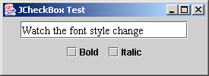
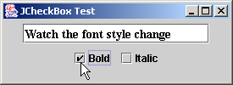
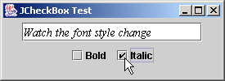
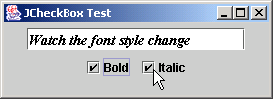
CheckBoxTest.java

Slide 35
RadioButtonTest.java
Lines 10-11
Line 12
1 // Fig. 13.12: RadioButtonTest.java
2 // Creating radio buttons using ButtonGroup and JRadioButton.
3 import java.awt.*;
4 import java.awt.event.*;
5 import javax.swing.*;
6
7 public class RadioButtonTest extends JFrame {
8 private JTextField field;
9 private Font plainFont, boldFont, italicFont, boldItalicFont;
10 private JRadioButton plainButton, boldButton, italicButton,
11 boldItalicButton;
12 private ButtonGroup radioGroup;
13
14 // create GUI and fonts
15 public RadioButtonTest()
16 {
17 super( "RadioButton Test" );
18
19 // get content pane and set its layout
20 Container container = getContentPane();
21 container.setLayout( new FlowLayout() );
22
23 // set up JTextField
24 field = new JTextField( "Watch the font style change", 25 );
25 container.add( field );
26
Declare four JRadioButton instances
JRadioButtons normally appear as a ButtonGroup

Slide 36
RadioButtonTest.java
Lines 28-35
Lines 41-45
27 // create radio buttons
28 plainButton = new JRadioButton( "Plain", true );
29 container.add( plainButton );
30
31 boldButton = new JRadioButton( "Bold", false );
32 container.add( boldButton );
33
34 italicButton = new JRadioButton( "Italic", false );
35 container.add( italicButton );
36
37 boldItalicButton = new JRadioButton( "Bold/Italic", false );
38 container.add( boldItalicButton );
39
40 // create logical relationship between JRadioButtons
41 radioGroup = new ButtonGroup();
42 radioGroup.add( plainButton );
43 radioGroup.add( boldButton );
44 radioGroup.add( italicButton );
45 radioGroup.add( boldItalicButton );
46
47 // create font objects
48 plainFont = new Font( "Serif", Font.PLAIN, 14 );
49 boldFont = new Font( "Serif", Font.BOLD, 14 );
50 italicFont = new Font( "Serif", Font.ITALIC, 14 );
51 boldItalicFont = new Font( "Serif", Font.BOLD + Font.ITALIC, 14 );
52 field.setFont( plainFont ); // set initial font
53
Instantiate JRadioButtons for manipulating JTextField text font
JRadioButtons belong to ButtonGroup

Slide 37
RadioButtonTest.java
Lines 55-60
54 // register events for JRadioButtons
55 plainButton.addItemListener( new RadioButtonHandler( plainFont ) );
56 boldButton.addItemListener( new RadioButtonHandler( boldFont ) );
57 italicButton.addItemListener(
58 new RadioButtonHandler( italicFont ) );
59 boldItalicButton.addItemListener(
60 new RadioButtonHandler( boldItalicFont ) );
61
62 setSize( 300, 100 );
63 setVisible( true );
64
65 } // end RadioButtonTest constructor
66
67 public static void main( String args[] )
68 {
69 RadioButtonTest application = new RadioButtonTest();
70 application.setDefaultCloseOperation( JFrame.EXIT_ON_CLOSE );
71 }
72
73 // private inner class to handle radio button events
74 private class RadioButtonHandler implements ItemListener {
75 private Font font;
76
77 public RadioButtonHandler( Font f )
78 {
79 font = f;
80 }
Register JRadioButtons to receive events from RadioButtonHandler

Slide 38
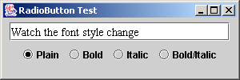
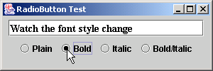
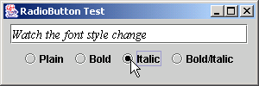
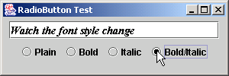
RadioButtonTest.java
Line 83
Line 85
81
82 // handle radio button events
83 public void itemStateChanged( ItemEvent event )
84 {
85 field.setFont( font );
86 }
87
88 } // end private inner class RadioButtonHandler
89
90 } // end class RadioButtonTest
When user selects JRadioButton, RadioButtonHandler invokes method itemStateChanged of all registered listeners
Set font corresponding to JRadioButton selected

Slide 39
13.9 JComboBox
JComboBox
  List of items from which user can select
  Also called a drop-down list

Slide 40
ComboBoxTest.java
1 // Fig. 13.13: ComboBoxTest.java
2 // Using a JComboBox to select an image to display.
3 import java.awt.*;
4 import java.awt.event.*;
5 import javax.swing.*;
6
7 public class ComboBoxTest extends JFrame {
8 private JComboBox imagesComboBox;
9 private JLabel label;
10
11 private String names[] =
12 { "bug1.gif", "bug2.gif", "travelbug.gif", "buganim.gif" };
13 private Icon icons[] = { new ImageIcon( names[ 0 ] ),
14 new ImageIcon( names[ 1 ] ), new ImageIcon( names[ 2 ] ),
15 new ImageIcon( names[ 3 ] ) };
16
17 // set up GUI
18 public ComboBoxTest()
19 {
20 super( "Testing JComboBox" );
21
22 // get content pane and set its layout
23 Container container = getContentPane();
24 container.setLayout( new FlowLayout() );
25

Slide 41
ComboBoxTest.java
Lines 27-28
Line 29
Line 34
Lines 38-39
26 // set up JComboBox and register its event handler
27 imagesComboBox = new JComboBox( names );
28 imagesComboBox.setMaximumRowCount( 3 );
29 imagesComboBox.addItemListener(
30
31 new ItemListener() { // anonymous inner class
32
33 // handle JComboBox event
34 public void itemStateChanged( ItemEvent event )
35 {
36 // determine whether check box selected
37 if ( event.getStateChange() == ItemEvent.SELECTED )
38 label.setIcon( icons[
39 imagesComboBox.getSelectedIndex() ] );
40 }
41
42 } // end anonymous inner class
43
44 ); // end call to addItemListener
45
46 container.add( imagesComboBox );
47
48 // set up JLabel to display ImageIcons
49 label = new JLabel( icons[ 0 ] );
50 container.add( label );
51
Instantiate JComboBox to show three Strings from names array at a time
Register JComboBox to receive events from anonymous ItemListener
When user selects item in JComboBox, ItemListener invokes method itemStateChanged of all registered listeners
Set appropriate Icon depending on user selection

Slide 42
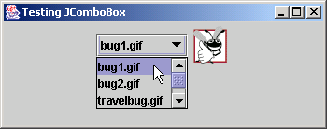
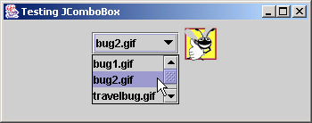
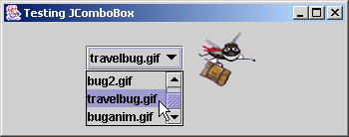
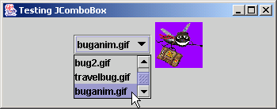
ComboBoxTest.java
52 setSize( 350, 100 );
53 setVisible( true );
54
55 } // end ComboBoxTest constructor
56
57 public static void main( String args[] )
58 {
59 ComboBoxTest application = new ComboBoxTest();
60 application.setDefaultCloseOperation( JFrame.EXIT_ON_CLOSE );
61 }
62
63 } // end class ComboBoxTest

Slide 43
13.10 JList
List
  Series of items
  user can select one or more items
  Single-selection vs. multiple-selection
  JList

Slide 44
ListTest.java
1 // Fig. 13.14: ListTest.java
2 // Selecting colors from a JList.
3 import java.awt.*;
4 import javax.swing.*;
5 import javax.swing.event.*;
6
7 public class ListTest extends JFrame {
8 private JList colorList;
9 private Container container;
10
11 private final String colorNames[] = { "Black", "Blue", "Cyan",
12 "Dark Gray", "Gray", "Green", "Light Gray", "Magenta",
13 "Orange", "Pink", "Red", "White", "Yellow" };
14
15 private final Color colors[] = { Color.BLACK, Color.BLUE, Color.CYAN,
16 Color.DARK_GRAY, Color.GRAY, Color.GREEN, Color.LIGHT_GRAY,
17 Color.MAGENTA, Color.ORANGE, Color.PINK, Color.RED, Color.WHITE,
18 Color.YELLOW };
19
20 // set up GUI
21 public ListTest()
22 {
23 super( "List Test" );
24
25 // get content pane and set its layout
26 container = getContentPane();
27 container.setLayout( new FlowLayout() );

Slide 45
ListTest.java
Line 30
Line 34
Line 38
Line 43
Lines 45-46
28
29 // create a list with items in colorNames array
30 colorList = new JList( colorNames );
31 colorList.setVisibleRowCount( 5 );
32
33 // do not allow multiple selections
34 colorList.setSelectionMode( ListSelectionModel.SINGLE_SELECTION );
35
36 // add a JScrollPane containing JList to content pane
37 container.add( new JScrollPane( colorList ) );
38 colorList.addListSelectionListener(
39
40 new ListSelectionListener() { // anonymous inner class
41
42 // handle list selection events
43 public void valueChanged( ListSelectionEvent event )
44 {
45 container.setBackground(
46 colors[ colorList.getSelectedIndex() ] );
47 }
48
49 } // end anonymous inner class
50
51 ); // end call to addListSelectionListener
52
Use colorNames array to populate JList
JList allows single selections
Register JList to receive events from anonymous ListSelectionListener
When user selects item in JList, ListSelectionListener invokes method valueChanged of all registered listeners
Set appropriate background depending on user selection

Slide 46
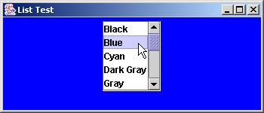
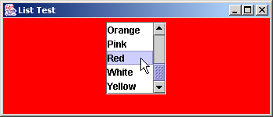
ListTest.java
53 setSize( 350, 150 );
54 setVisible( true );
55
56 } // end ListTest constructor
57
58 public static void main( String args[] )
59 {
60 ListTest application = new ListTest();
61 application.setDefaultCloseOperation( JFrame.EXIT_ON_CLOSE );
62 }
63
64 } // end class ListTest

Slide 47
13.11 Multiple-Selection Lists
Multiple-selection list
  Select many items from Jlist
  Allows continuous range selection

Slide 48
MultipleSelectionTest.java
Lines 10-12 and 24
Lines 26-27
1 // Fig. 13.15: MultipleSelectionTest.java
2 // Copying items from one List to another.
3 import java.awt.*;
4 import java.awt.event.*;
5 import javax.swing.*;
6
7 public class MultipleSelectionTest extends JFrame {
8 private JList colorList, copyList;
9 private JButton copyButton;
10 private final String colorNames[] = { "Black", "Blue", "Cyan",
11 "Dark Gray", "Gray", "Green", "Light Gray", "Magenta", "Orange",
12 "Pink", "Red", "White", "Yellow" };
13
14 // set up GUI
15 public MultipleSelectionTest()
16 {
17 super( "Multiple Selection Lists" );
18
19 // get content pane and set its layout
20 Container container = getContentPane();
21 container.setLayout( new FlowLayout() );
22
23 // set up JList colorList
24 colorList = new JList( colorNames );
25 colorList.setVisibleRowCount( 5 );
26 colorList.setSelectionMode(
27 ListSelectionModel.MULTIPLE_INTERVAL_SELECTION );
28 container.add( new JScrollPane( colorList ) );
Use colorNames array to populate JList
JList colorList allows multiple selections

Slide 49
MultipleSelectionTest.java
Line 40
Lines 54-55
29
30 // create copy button and register its listener
31 copyButton = new JButton( "Copy >>>" );
32 copyButton.addActionListener(
33
34 new ActionListener() { // anonymous inner class
35
36 // handle button event
37 public void actionPerformed( ActionEvent event )
38 {
39 // place selected values in copyList
40 copyList.setListData( colorList.getSelectedValues() );
41 }
42
43 } // end anonymous inner class
44
45 ); // end call to addActionListener
46
47 container.add( copyButton );
48
49 // set up JList copyList
50 copyList = new JList( );
51 copyList.setVisibleRowCount( 5 );
52 copyList.setFixedCellWidth( 100 );
53 copyList.setFixedCellHeight( 15 );
54 copyList.setSelectionMode(
55 ListSelectionModel.SINGLE_INTERVAL_SELECTION );
56 container.add( new JScrollPane( copyList ) );
When user presses JButton, JList copyList adds items that user selected from JList colorList
JList colorList allows single selections

Slide 50
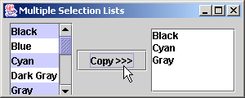
MultipleSelectionTest.java
57
58 setSize( 300, 130 );
59 setVisible( true );
60
61 } // end constructor MultipleSelectionTest
62
63 public static void main( String args[] )
64 {
65 MultipleSelectionTest application = new MultipleSelectionTest();
66 application.setDefaultCloseOperation( JFrame.EXIT_ON_CLOSE );
67 }
68
69 } // end class MultipleSelectionTest

Slide 51
13.12 Mouse Event Handling
Event-listener interfaces for mouse events
  MouseListener
  MouseMotionListener
  Listen for MouseEvents

Slide 52
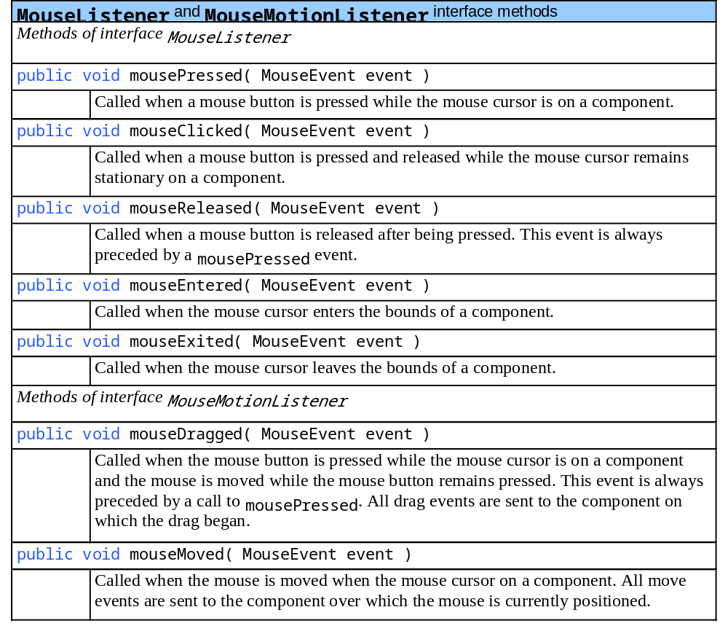
Fig. 13.16 MouseListener and MouseMotionListener interface methods

Slide 53
MouseTracker.java
Lines 20-21
1 // Fig. 13.17: MouseTracker.java
2 // Demonstrating mouse events.
3 import java.awt.*;
4 import java.awt.event.*;
5 import javax.swing.*;
6
7 public class MouseTracker extends JFrame
8 implements MouseListener, MouseMotionListener {
9
10 private JLabel statusBar;
11
12 // set up GUI and register mouse event handlers
13 public MouseTracker()
14 {
15 super( "Demonstrating Mouse Events" );
16
17 statusBar = new JLabel();
18 getContentPane().add( statusBar, BorderLayout.SOUTH );
19
20 addMouseListener( this ); // listens for own mouse and
21 addMouseMotionListener( this ); // mouse-motion events
22
23 setSize( 275, 100 );
24 setVisible( true );
25 }
26
Register JFrame to receive mouse events

Slide 54
MouseTracker.java
Line 29
Line 36
Line 43
Line 50
27 // MouseListener event handlers
28 // handle event when mouse released immediately after press
29 public void mouseClicked( MouseEvent event )
30 {
31 statusBar.setText( "Clicked at [" + event.getX() +
32 ", " + event.getY() + "]" );
33 }
34
35 // handle event when mouse pressed
36 public void mousePressed( MouseEvent event )
37 {
38 statusBar.setText( "Pressed at [" + event.getX() +
39 ", " + event.getY() + "]" );
40 }
41
42 // handle event when mouse released after dragging
43 public void mouseReleased( MouseEvent event )
44 {
45 statusBar.setText( "Released at [" + event.getX() +
46 ", " + event.getY() + "]" );
47 }
48
49 // handle event when mouse enters area
50 public void mouseEntered( MouseEvent event )
51 {
Invoked when user presses and releases mouse button
Invoked when user presses mouse button
Invoked when user releases mouse button after dragging mouse
Invoked when mouse cursor enters JFrame

Slide 55
MouseTracker.java
Line 58
Line 66
Line 73
52 statusBar.setText( "Mouse entered at [" + event.getX() +
53 ", " + event.getY() + "]" );
54 getContentPane().setBackground( Color.GREEN );
55 }
56
57 // handle event when mouse exits area
58 public void mouseExited( MouseEvent event )
59 {
60 statusBar.setText( "Mouse outside window" );
61 getContentPane().setBackground( Color.WHITE );
62 }
63
64 // MouseMotionListener event handlers
65 // handle event when user drags mouse with button pressed
66 public void mouseDragged( MouseEvent event )
67 {
68 statusBar.setText( "Dragged at [" + event.getX() +
69 ", " + event.getY() + "]" );
70 }
71
72 // handle event when user moves mouse
73 public void mouseMoved( MouseEvent event )
74 {
75 statusBar.setText( "Moved at [" + event.getX() +
76 ", " + event.getY() + "]" );
77 }
78
Invoked when mouse cursor exits JFrame
Invoked when user drags mouse cursor
Invoked when user moves mouse cursor

Slide 56
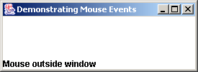
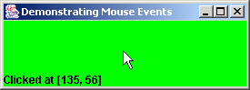
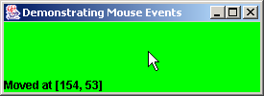

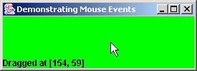
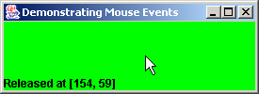
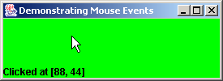
MouseTracker.java
79 public static void main( String args[] )
80 {
81 MouseTracker application = new MouseTracker();
82 application.setDefaultCloseOperation( JFrame.EXIT_ON_CLOSE );
83 }
84
85 } // end class MouseTracker

Slide 57
13.13 Adapter Classes
Adapter class
  Implements interface
  Provides default implementation of each interface method
  Used when all methods in interface is not needed

Slide 58
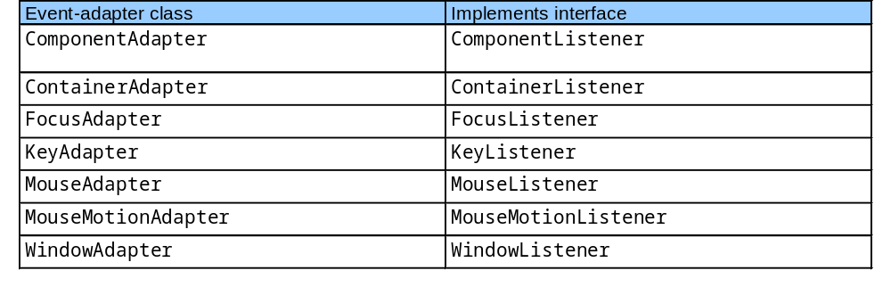
Fig. 13.18 Event-adapter classes and the interfaces they implement in package java.awt.event

Slide 59
Painter.java
Line 22
1 // Fig. 13.19: Painter.java
2 // Using class MouseMotionAdapter.
3 import java.awt.*;
4 import java.awt.event.*;
5 import javax.swing.*;
6
7 public class Painter extends JFrame {
8 private int pointCount = 0;
9
10 // array of 1000 java.awt.Point references
11 private Point points[] = new Point[ 1000 ];
12
13 // set up GUI and register mouse event handler
14 public Painter()
15 {
16 super( "A simple paint program" );
17
18 // create a label and place it in SOUTH of BorderLayout
19 getContentPane().add( new JLabel( "Drag the mouse to draw" ),
20 BorderLayout.SOUTH );
21
22 addMouseMotionListener(
23
24 new MouseMotionAdapter() { // anonymous inner class
25
Register MouseMotionListener to listen for window’s mouse-motion events

Slide 60
Painter.java
Line 27
Line 30
Line 51
26 // store drag coordinates and repaint
27 public void mouseDragged( MouseEvent event )
28 {
29 if ( pointCount < points.length ) {
30 points[ pointCount ] = event.getPoint();
31 ++pointCount;
32 repaint();
33 }
34 }
35
36 } // end anonymous inner class
37
38 ); // end call to addMouseMotionListener
39
40 setSize( 300, 150 );
41 setVisible( true );
42
43 } // end Painter constructor
44
45 // draw oval in a 4-by-4 bounding box at specified location on window
46 public void paint( Graphics g )
47 {
48 super.paint( g ); // clears drawing area
49
50 for ( int i = 0; i < points.length && points[ i ] != null; i++ )
51 g.fillOval( points[ i ].x, points[ i ].y, 4, 4 );
52 }
Override method mouseDragged, but not method mouseMoved
Store coordinates where mouse was dragged, then repaint JFrame
Draw circle of diameter 4 where user dragged cursor

Slide 61
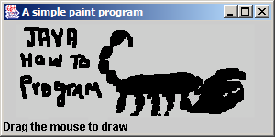
Painter.java
53
54 public static void main( String args[] )
55 {
56 Painter application = new Painter();
57 application.setDefaultCloseOperation( JFrame.EXIT_ON_CLOSE );
58 }
59
60 } // end class Painter

Slide 62
MouseDetails.java
Line 15
1 // Fig. 13.20: MouseDetails.java
2 // Demonstrating mouse clicks and distinguishing between mouse buttons.
3 import java.awt.*;
4 import java.awt.event.*;
5 import javax.swing.*;
6
7 public class MouseDetails extends JFrame {
8 private int xPos, yPos;
9
10 // set title bar String; register mouse listener; size and show window
11 public MouseDetails()
12 {
13 super( "Mouse clicks and buttons" );
14
15 addMouseListener( new MouseClickHandler() );
16
17 setSize( 350, 150 );
18 setVisible( true );
19 }
20
21 // draw String at location where mouse was clicked
22 public void paint( Graphics g )
23 {
24 // call superclass paint method
25 super.paint( g );
26
Register mouse listener

Slide 63
MouseDetails.java
Line 41
Lines 43-44
Line 46
Line 48
Line 51
27 g.drawString( "Clicked @ [" + xPos + ", " + yPos + "]",
28 xPos, yPos );
29 }
30
31 public static void main( String args[] )
32 {
33 MouseDetails application = new MouseDetails();
34 application.setDefaultCloseOperation( JFrame.EXIT_ON_CLOSE );
35 }
36
37 // inner class to handle mouse events
38 private class MouseClickHandler extends MouseAdapter {
39
40 // handle mouse click event and determine which button was pressed
41 public void mouseClicked( MouseEvent event )
42 {
43 xPos = event.getX();
44 yPos = event.getY();
45
46 String title = "Clicked " + event.getClickCount() + " time(s)";
47
48 if ( event.isMetaDown() ) // right mouse button
49 title += " with right mouse button";
50
51 else if ( event.isAltDown() ) // middle mouse button
52 title += " with center mouse button";
Invoke method mouseClicked when user clicks mouse
Store mouse-cursor coordinates where mouse was clicked
Determine number of times user has clicked mouse
Determine if user clicked right mouse button
Determine if user clicked middle mouse button

Slide 64
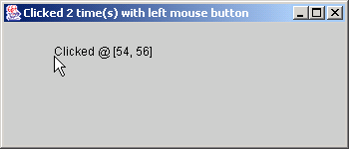
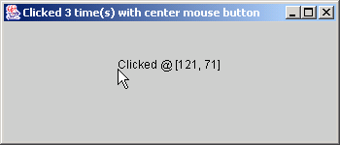
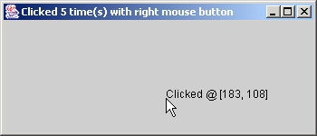
MouseDetails.java
53
54 else // left mouse button
55 title += " with left mouse button";
56
57 setTitle( title ); // set title bar of window
58 repaint();
59
60 } // end method mouseClicked
61
62 } // end private inner class MouseClickHandler
63
64 } // end class MouseDetails

Slide 65
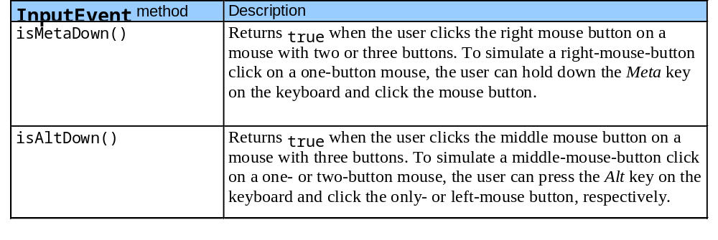
Fig. 13.21 InputEvent methods that help distinguish among left-, center- and right-mouse-button clicks

Slide 66
13.14 Key Event Handling
Interface KeyListener
  Handles key events
    Generated when keys on keyboard are pressed and released
    KeyEvent
      Contains virtual key code that represents key

Slide 67
KeyDemo.java
Line 23
1 // Fig. 13.22: KeyDemo.java
2 // Demonstrating keystroke events.
3 import java.awt.*;
4 import java.awt.event.*;
5 import javax.swing.*;
6
7 public class KeyDemo extends JFrame implements KeyListener {
8 private String line1 = "", line2 = "", line3 = "";
9 private JTextArea textArea;
10
11 // set up GUI
12 public KeyDemo()
13 {
14 super( "Demonstrating Keystroke Events" );
15
16 // set up JTextArea
17 textArea = new JTextArea( 10, 15 );
18 textArea.setText( "Press any key on the keyboard..." );
19 textArea.setEnabled( false );
20 textArea.setDisabledTextColor( Color.BLACK );
21 getContentPane().add( textArea );
22
23 addKeyListener( this ); // allow frame to process Key events
24
25 setSize( 350, 100 );
26 setVisible( true );
Register JFrame for key events

Slide 68
KeyDemo.java
Line 31
Line 33 and 40
Line 38
Line 45
27
28 } // end KeyDemo constructor
29
30 // handle press of any key
31 public void keyPressed( KeyEvent event )
32 {
33 line1 = "Key pressed: " + event.getKeyText( event.getKeyCode() );
34 setLines2and3( event );
35 }
36
37 // handle release of any key
38 public void keyReleased( KeyEvent event )
39 {
40 line1 = "Key released: " + event.getKeyText( event.getKeyCode() );
41 setLines2and3( event );
42 }
43
44 // handle press of an action key
45 public void keyTyped( KeyEvent event )
46 {
47 line1 = "Key typed: " + event.getKeyChar();
48 setLines2and3( event );
49 }
50
51 // set second and third lines of output
52 private void setLines2and3( KeyEvent event )
53 {
Called when user presses key
Return virtual key code
Called when user releases key
Called when user types key

Slide 69
KeyDemo.java
Line 57
54 line2 = "This key is " + ( event.isActionKey() ? "" : "not " ) +
55 "an action key";
56
57 String temp = event.getKeyModifiersText( event.getModifiers() );
58
59 line3 = "Modifier keys pressed: " +
60 ( temp.equals( "" ) ? "none" : temp );
61
62 textArea.setText( line1 + "\n" + line2 + "\n" + line3 + "\n" );
63 }
64
65 public static void main( String args[] )
66 {
67 KeyDemo application = new KeyDemo();
68 application.setDefaultCloseOperation( JFrame.EXIT_ON_CLOSE );
69 }
70
71 } // end class KeyDemo
Determine if modifier keys (e.g., Alt, Ctrl, Meta and Shift) were used

Slide 70
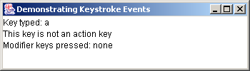
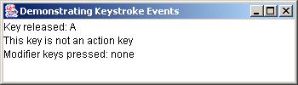
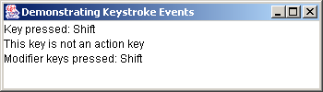




KeyDemo.java

Slide 71
13.15 Layout Managers
Layout managers
  Provided for arranging GUI components
  Provide basic layout capabilities
  Processes layout details
  Programmer can concentrate on basic “look and feel”
  Interface LayoutManager

Slide 72

Fig. 13.23 Layout managers

Slide 73
13.15.1 FlowLayout
FlowLayout
  Most basic layout manager
  GUI components placed in container from left to right

Slide 74
FlowLayoutDemo.java
Lines 17 and 21
1 // Fig. 13.24: FlowLayoutDemo.java
2 // Demonstrating FlowLayout alignments.
3 import java.awt.*;
4 import java.awt.event.*;
5 import javax.swing.*;
6
7 public class FlowLayoutDemo extends JFrame {
8 private JButton leftButton, centerButton, rightButton;
9 private Container container;
10 private FlowLayout layout;
11
12 // set up GUI and register button listeners
13 public FlowLayoutDemo()
14 {
15 super( "FlowLayout Demo" );
16
17 layout = new FlowLayout();
18
19 // get content pane and set its layout
20 container = getContentPane();
21 container.setLayout( layout );
22
23 // set up leftButton and register listener
24 leftButton = new JButton( "Left" );
25 container.add( leftButton );
Set layout as FlowLayout

Slide 75
FlowLayoutDemo.java
Line 33
Line 53
26 leftButton.addActionListener(
27
28 new ActionListener() { // anonymous inner class
29
30 // process leftButton event
31 public void actionPerformed( ActionEvent event )
32 {
33 layout.setAlignment( FlowLayout.LEFT );
34
35 // realign attached components
36 layout.layoutContainer( container );
37 }
38
39 } // end anonymous inner class
40
41 ); // end call to addActionListener
42
43 // set up centerButton and register listener
44 centerButton = new JButton( "Center" );
45 container.add( centerButton );
46 centerButton.addActionListener(
47
48 new ActionListener() { // anonymous inner class
49
50 // process centerButton event
51 public void actionPerformed( ActionEvent event )
52 {
53 layout.setAlignment( FlowLayout.CENTER );
54
When user presses left JButton, left align components
When user presses center JButton, center components

Slide 76
FlowLayoutDemo.java
Line 71
55 // realign attached components
56 layout.layoutContainer( container );
57 }
58 }
59 );
60
61 // set up rightButton and register listener
62 rightButton = new JButton( "Right" );
63 container.add( rightButton );
64 rightButton.addActionListener(
65
66 new ActionListener() { // anonymous inner class
67
68 // process rightButton event
69 public void actionPerformed( ActionEvent event )
70 {
71 layout.setAlignment( FlowLayout.RIGHT );
72
73 // realign attached components
74 layout.layoutContainer( container );
75 }
76 }
77 );
78
79 setSize( 300, 75 );
80 setVisible( true );
When user presses right JButton, right components

Slide 77





FlowLayoutDemo.java
81
82 } // end constructor FlowLayoutDemo
83
84 public static void main( String args[] )
85 {
86 FlowLayoutDemo application = new FlowLayoutDemo();
87 application.setDefaultCloseOperation( JFrame.EXIT_ON_CLOSE );
88 }
89
90 } // end class FlowLayoutDemo

Slide 78
13.15.2 BorderLayout
BorderLayout
  Arranges components into five regions
    NORTH (top of container)
    SOUTH (bottom of container)
    EAST (left of container)
    WEST (right of container)
    CENTER (center of container)

Slide 79
BorderLayoutDemo.java
Lines 18 and 22
1 // Fig. 13.25: BorderLayoutDemo.java
2 // Demonstrating BorderLayout.
3 import java.awt.*;
4 import java.awt.event.*;
5 import javax.swing.*;
6
7 public class BorderLayoutDemo extends JFrame implements ActionListener {
8 private JButton buttons[];
9 private final String names[] = { "Hide North", "Hide South",
10 "Hide East", "Hide West", "Hide Center" };
11 private BorderLayout layout;
12
13 // set up GUI and event handling
14 public BorderLayoutDemo()
15 {
16 super( "BorderLayout Demo" );
17
18 layout = new BorderLayout( 5, 5 ); // 5 pixel gaps
19
20 // get content pane and set its layout
21 Container container = getContentPane();
22 container.setLayout( layout );
23
24 // instantiate button objects
25 buttons = new JButton[ names.length ];
26
Set layout as BorderLayout with 5-pixel horizontal and vertical gaps

Slide 80
BorderLayoutDemo.java
Lines 33-37
Lines 50 and 52
27 for ( int count = 0; count < names.length; count++ ) {
28 buttons[ count ] = new JButton( names[ count ] );
29 buttons[ count ].addActionListener( this );
30 }
31
32 // place buttons in BorderLayout; order not important
33 container.add( buttons[ 0 ], BorderLayout.NORTH );
34 container.add( buttons[ 1 ], BorderLayout.SOUTH );
35 container.add( buttons[ 2 ], BorderLayout.EAST );
36 container.add( buttons[ 3 ], BorderLayout.WEST );
37 container.add( buttons[ 4 ], BorderLayout.CENTER );
38
39 setSize( 300, 200 );
40 setVisible( true );
41
42 } // end constructor BorderLayoutDemo
43
44 // handle button events
45 public void actionPerformed( ActionEvent event )
46 {
47 for ( int count = 0; count < buttons.length; count++ )
48
49 if ( event.getSource() == buttons[ count ] )
50 buttons[ count ].setVisible( false );
51 else
52 buttons[ count ].setVisible( true );
Place JButtons in regions specified by BorderLayout
When JButtons are “invisible,” they are not displayed on screen, and BorderLayout rearranges

Slide 81


BorderLayoutDemo.java
53
54 // re-layout the content pane
55 layout.layoutContainer( getContentPane() );
56 }
57
58 public static void main( String args[] )
59 {
60 BorderLayoutDemo application = new BorderLayoutDemo();
61 application.setDefaultCloseOperation( JFrame.EXIT_ON_CLOSE );
62 }
63
64 } // end class BorderLayoutDemo

Slide 82




BorderLayoutDemo.java

Slide 83
13.15.3 GridLayout
GridLayout
  Divides container into grid of specified row an columns
  Components are added starting at top-left cell
    Proceed left-to-fight until row is full

Slide 84
GridLayoutDemo.java
Line 21
Line 22
1 // Fig. 13.26: GridLayoutDemo.java
2 // Demonstrating GridLayout.
3 import java.awt.*;
4 import java.awt.event.*;
5 import javax.swing.*;
6
7 public class GridLayoutDemo extends JFrame implements ActionListener {
8 private JButton buttons[];
9 private final String names[] =
10 { "one", "two", "three", "four", "five", "six" };
11 private boolean toggle = true;
12 private Container container;
13 private GridLayout grid1, grid2;
14
15 // set up GUI
16 public GridLayoutDemo()
17 {
18 super( "GridLayout Demo" );
19
20 // set up layouts
21 grid1 = new GridLayout( 2, 3, 5, 5 );
22 grid2 = new GridLayout( 3, 2 );
23
24 // get content pane and set its layout
25 container = getContentPane();
26 container.setLayout( grid1 );
Create GridLayout grid1 with 2 rows and 3 columns
Create GridLayout grid2 with 3 rows and 2 columns

Slide 85
GridLayoutDemo.java
Lines 46 and 48
27
28 // create and add buttons
29 buttons = new JButton[ names.length ];
30
31 for ( int count = 0; count < names.length; count++ ) {
32 buttons[ count ] = new JButton( names[ count ] );
33 buttons[ count ].addActionListener( this );
34 container.add( buttons[ count ] );
35 }
36
37 setSize( 300, 150 );
38 setVisible( true );
39
40 } // end constructor GridLayoutDemo
41
42 // handle button events by toggling between layouts
43 public void actionPerformed( ActionEvent event )
44 {
45 if ( toggle )
46 container.setLayout( grid2 );
47 else
48 container.setLayout( grid1 );
49
50 toggle = !toggle; // set toggle to opposite value
51 container.validate();
52 }
Toggle current GridLayout when user presses JButton

Slide 86


GridLayoutDemo.java
53
54 public static void main( String args[] )
55 {
56 GridLayoutDemo application = new GridLayoutDemo();
57 application.setDefaultCloseOperation( JFrame.EXIT_ON_CLOSE );
58 }
59
60 } // end class GridLayoutDemo

Slide 87
13.16 Panels
Panel
  Helps organize components
  Class JPanel is JComponent subclass
  May have components (and other panels) added to them

Slide 88
PanelDemo.java
Line 23
1 // Fig. 13.27: PanelDemo.java
2 // Using a JPanel to help lay out components.
3 import java.awt.*;
4 import java.awt.event.*;
5 import javax.swing.*;
6
7 public class PanelDemo extends JFrame {
8 private JPanel buttonPanel;
9 private JButton buttons[];
10
11 // set up GUI
12 public PanelDemo()
13 {
14 super( "Panel Demo" );
15
16 // get content pane
17 Container container = getContentPane();
18
19 // create buttons array
20 buttons = new JButton[ 5 ];
21
22 // set up panel and set its layout
23 buttonPanel = new JPanel();
24 buttonPanel.setLayout( new GridLayout( 1, buttons.length ) );
25
Create JPanel to hold JButtons

Slide 89

PanelDemo.java
Line 29
Line 32
26 // create and add buttons
27 for ( int count = 0; count < buttons.length; count++ ) {
28 buttons[ count ] = new JButton( "Button " + ( count + 1 ) );
29 buttonPanel.add( buttons[ count ] );
30 }
31
32 container.add( buttonPanel, BorderLayout.SOUTH );
33
34 setSize( 425, 150 );
35 setVisible( true );
36
37 } // end constructor PanelDemo
38
39 public static void main( String args[] )
40 {
41 PanelDemo application = new PanelDemo();
42 application.setDefaultCloseOperation( JFrame.EXIT_ON_CLOSE );
43 }
44
45 } // end class PanelDemo
Add JButtons to JPanel
Add JPanel to SOUTH region of Container

Slide 90
13.17 (Optional Case Study) Thinking About Objects: Use Cases
Use case
  Represents capabilities that systems provide to clients
    Automated-teller-machine use cases
      “Deposit Money,” “Withdraw Money,” “Transfer Funds”

Slide 91
13.17 (Optional Case Study) Thinking About Objects: Use Cases
Use-case diagram
  Models use cases in system
  Facilitates system-requirements gathering
  Notation
    Stick figure represents actor
      Actor represents set of roles that external entity can play
    System box (rectangle) contains system use cases
    Ovals represent use cases

Slide 92
13.17 (Optional Case Study) Thinking About Objects: Use Cases
Elevator-simulation use cases
  “Create Person”
    From user’s perspective
  “Relocate Person” (move to other floor)
    From Person’s perspective
Constructing GUI
  Use “Create Person” use case

Slide 93
Fig. 13.28 Use case diagram for elevator simulation from user’s perspective
Create Person
User

Slide 94
Fig. 13.29 Use case diagram from the perspective of a Person
Relocate Person
Person

